Slide 1
APPLIED MATHEMATICS PROJECT
GROUP 11
Tushar Kumar – CH23BTECH11043
Sanjay Meena – CH23BTECH11038
Lavudi Sai – CH23BTECH11026
Hasini L – CH23BTECH11027

Slide 2
Objective
To use Li-Rinzel model to simulate Ca2+ ion concentration
Formulating the problem as a regression problem assuming V2, V3 as parameters changing with time
Using objective function as RMSE and KL-Divergence
Plot the surface plots of the objective function with parameters

Slide 3
Simulating Process
Simulation of data is done using Li-Rinzel model with V2 and V3 as changing parameters
We guess the value of V2, V3 at a initial of 0.1, 0.1
The data is divided in time intervals of length 200s
Using the minimise function in the scipy.optimize library optimized values of V2, V3 is calculated for each interval with the initial values as optimized values from the previous interval
The final value obtained is assumed to be the optimized values

Slide 4
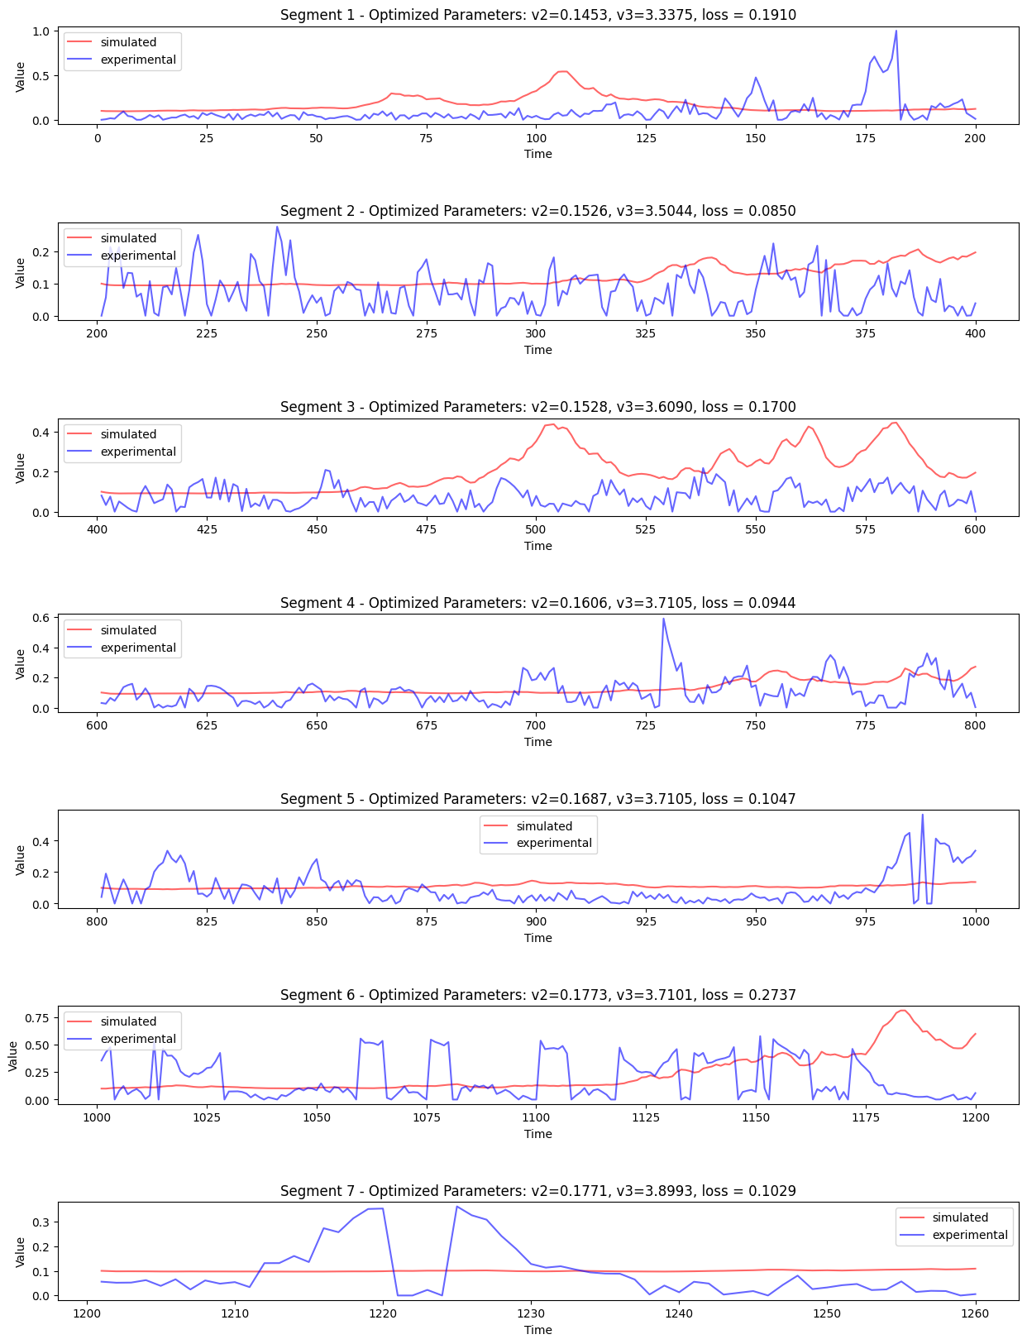
Results
The following is the plot of simulated vs experimental data for each interval.
The loss value is also printed.
The loss function can be chosen from RMSE and KL-Divergence.
Here the loss function used is RMSE.

Slide 5
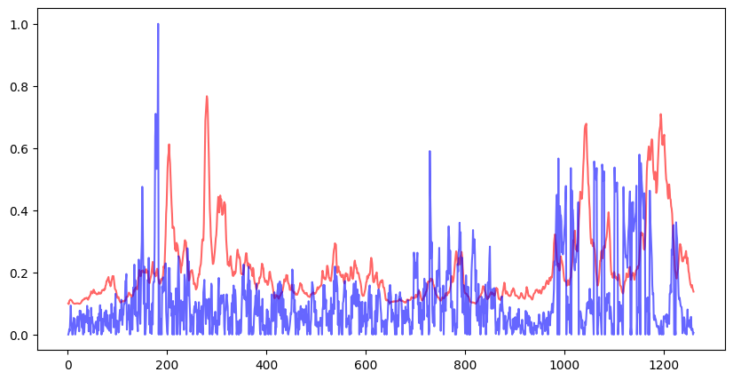
Following is the plot of simulation achieved.
V2: 0.162044430362084 V3: 3.640190982921923
KLD: -178.63484162999737 RMSE: 0.19367381730696295

Slide 6
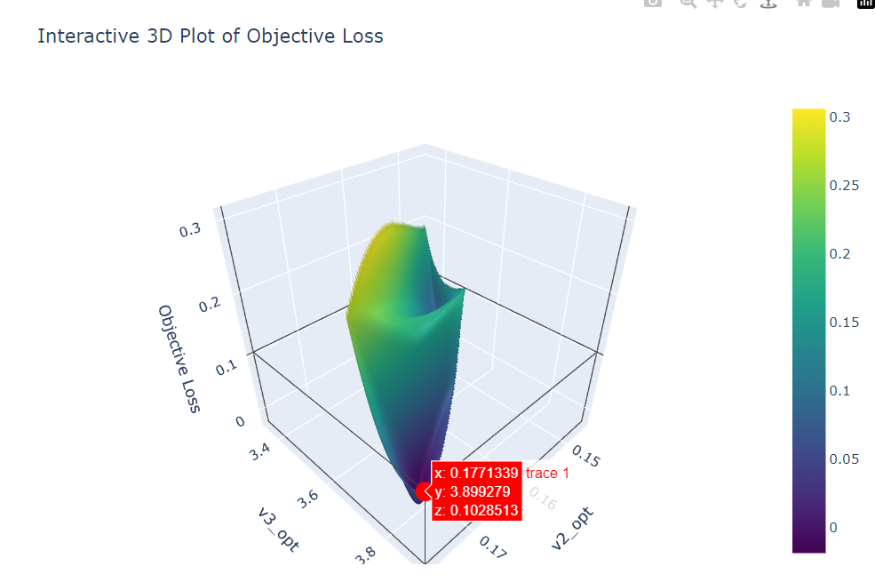
Loss vs V2 vs V3 graph.
Since very few datapoints were available interpolation has been done using griddata function from scipy.interpolate library.
Cubic function is used to interpolate the data.

